Slide 1

Emotion Detection using Convolutional Neural Networks
Jonathan Buser
https://github.com/SpaceMonkey0453/Capstone-Project

Slide 2
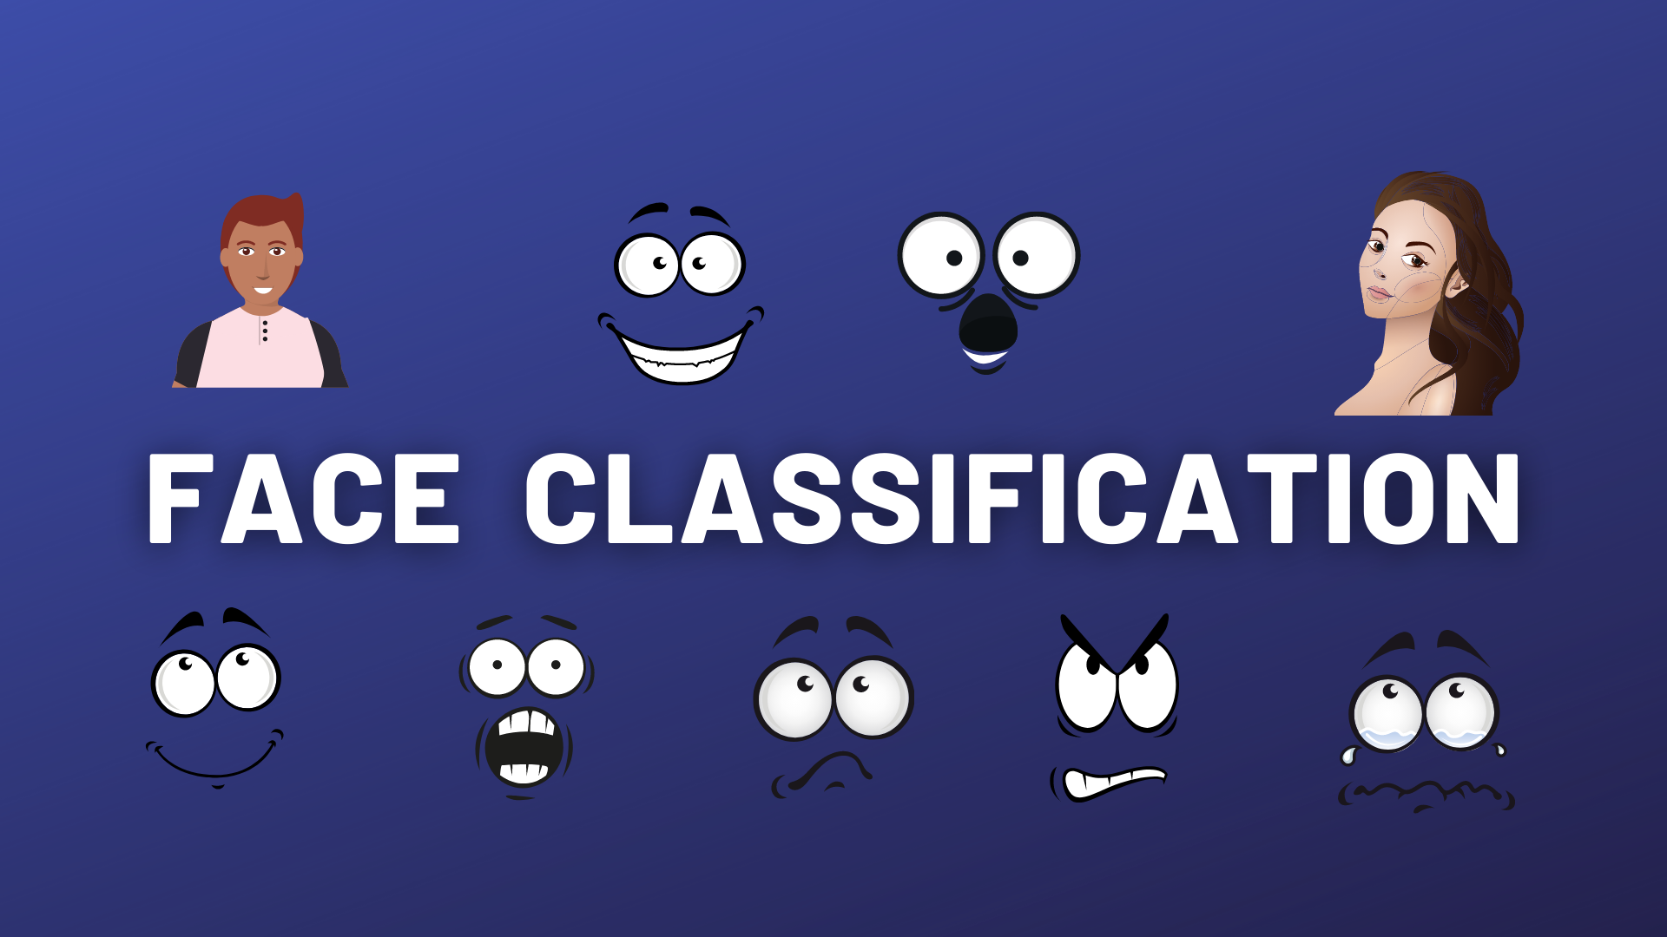
Goal
Develop an emotion detection model using facial expression images
Stakeholders
Businesses, healthcare providers, researchers, and developers interested in emotion recognition applications
Needs
Accurate and efficient emotion detection to enhance user experiences, monitor mental health, and improve human-computer interaction

Slide 3
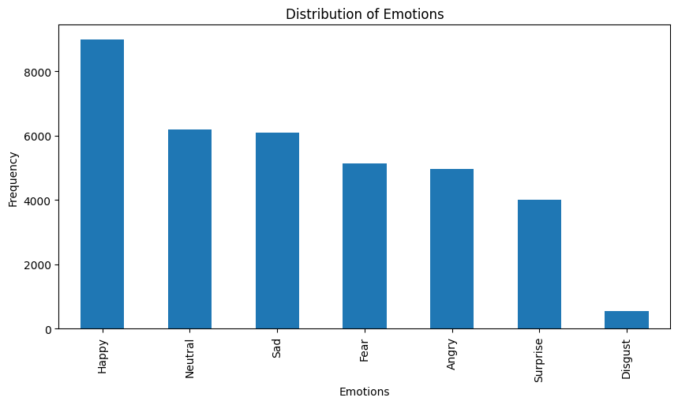
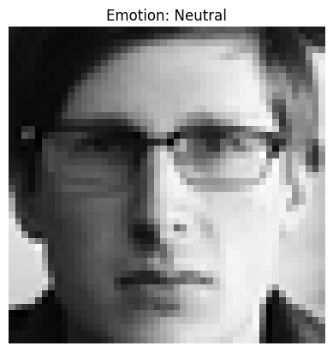
The data
FER2013 dataset: 35,887 grayscale images (48x48 pixels) with 7 emotion labels
Data distribution: Uneven, with most images labeled as "Happy" or "Neutral"
Preprocessing: Normalization, train-test split

Slide 4

Model Building Process
CNN 1
Baseline model with two convolutional layers
Final model with six convolutional layers and batch normalization
Larger randomized search for optimal hyperparameters
Grid search
CNN 2

Slide 5
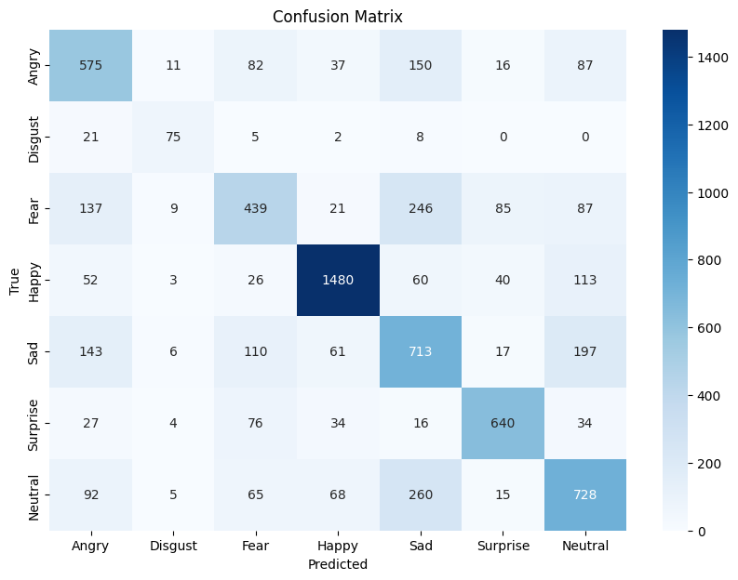
Model Evaluation and Results
Test loss
1.0121
Test accuracy
%64.78

Slide 6
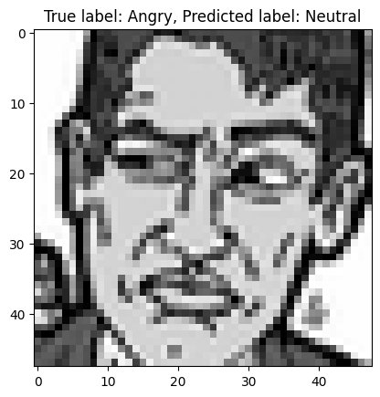
Example of a Bad Prediction
The model struggles with certain images, such as those with cartoonish features

Slide 7
Conclusion and Future Improvements
Address class imbalance with more balanced data
Transfer learning with pre-trained models
$$$ - To buy better data and hardware that can run it.

Slide 8


THANK YOU
Jonathan Buser
https://github.com/SpaceMonkey0453
https://www.linkedin.com/in/jonathan-buser/

